Slide 1
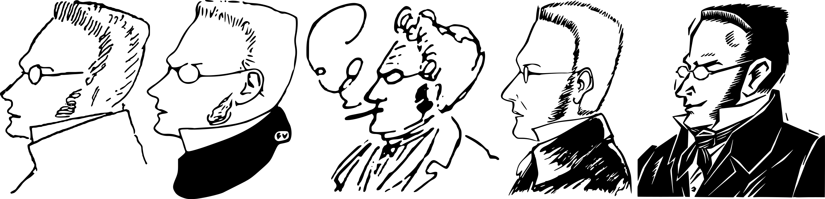
Max Stirner
GENTRAIN
Stephanie Spoto
Monterey Peninsula College

Slide 2
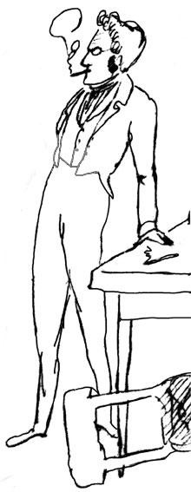
Johann Kaspar Schmidt
(25 October 1806 – 26 June 1856)
Known professionally as Max Stirner
German post-Hegelian philosopher → focus on Hegelian idea of self-consciousness and social alienation
Considered to be one of the pioneers of modern nihilism, postmodernism, existentialism, psychoanalytic theory, and individualist anarchism
Major work, The Ego and Its Own (1844)
  Der Einzige und sein Eigentum, trans. The Individual and his Property, literally as The Only One and His Property

Slide 3
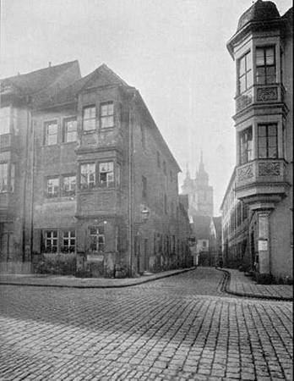
Stirner’s Biography
Stirner's birthplace in Bayreuth
Only little is known about his life → mostly through 1898 biography by Scottish writer John Henry Mackay, who lived most of his life in Germany
  Biography published in German originally, and only translated into English in 2005
Stirner was the only child, and his father died when Stirner was only one-years-old. Mother remarried and moved them to Poland.
Returned to Germany to study philology at the University of Berlin, where he was a student of Hegel and attended his lectures → would become an inspiration for Stirner’s thought
  Attended his lectures on the history of philosophy and the philosophy of religion.
Moved his studies to the University of Erlangen where he was a student at the same time as Ludwig Feuerbach → member of the Young Hegelians
Returned to Berlin for his teaching certificate, but was unable to secure full-time teaching from the Prussian government
In 1841, began to frequent discussions with the Young Hegelians with Marx, Engels, and others

Slide 4
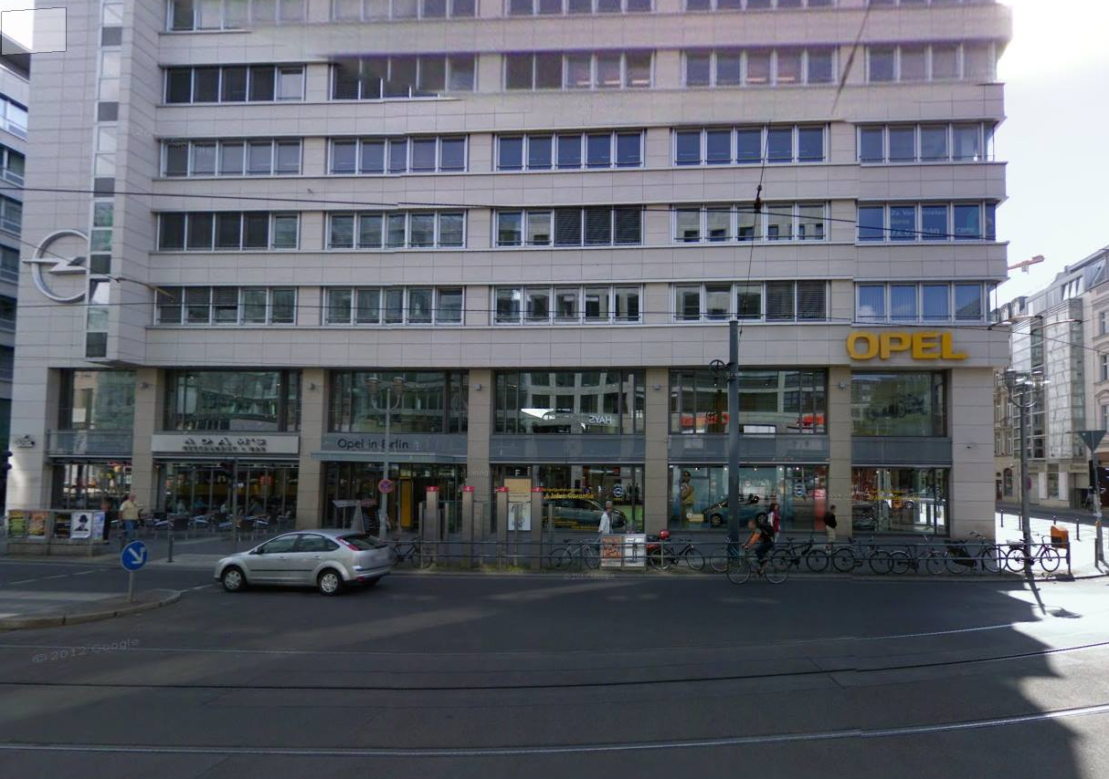
The Young Hegelians
These debates and discussions would take place at Hippel’s, a bar in Friedrichstraße
Stirner met and spent much time with Engels (unclear if Stirner and Marx had a relationship)
  Engels: Stirner and he were “great friends”
At these discussions with the Young Hegelians, Stirner would hardly ever talk → much more of a listener and was a faithful member
There are not many portraits of Stirner → one of the existing portraits from someone who had met him was a drawing that Engels did forty years later from memory (at the request of Mackay for his biography of Stirner)
  This and the group sketch of the Young Hegelians at Hippel’s are perhaps the only firsthand images of Stirner.

Slide 5
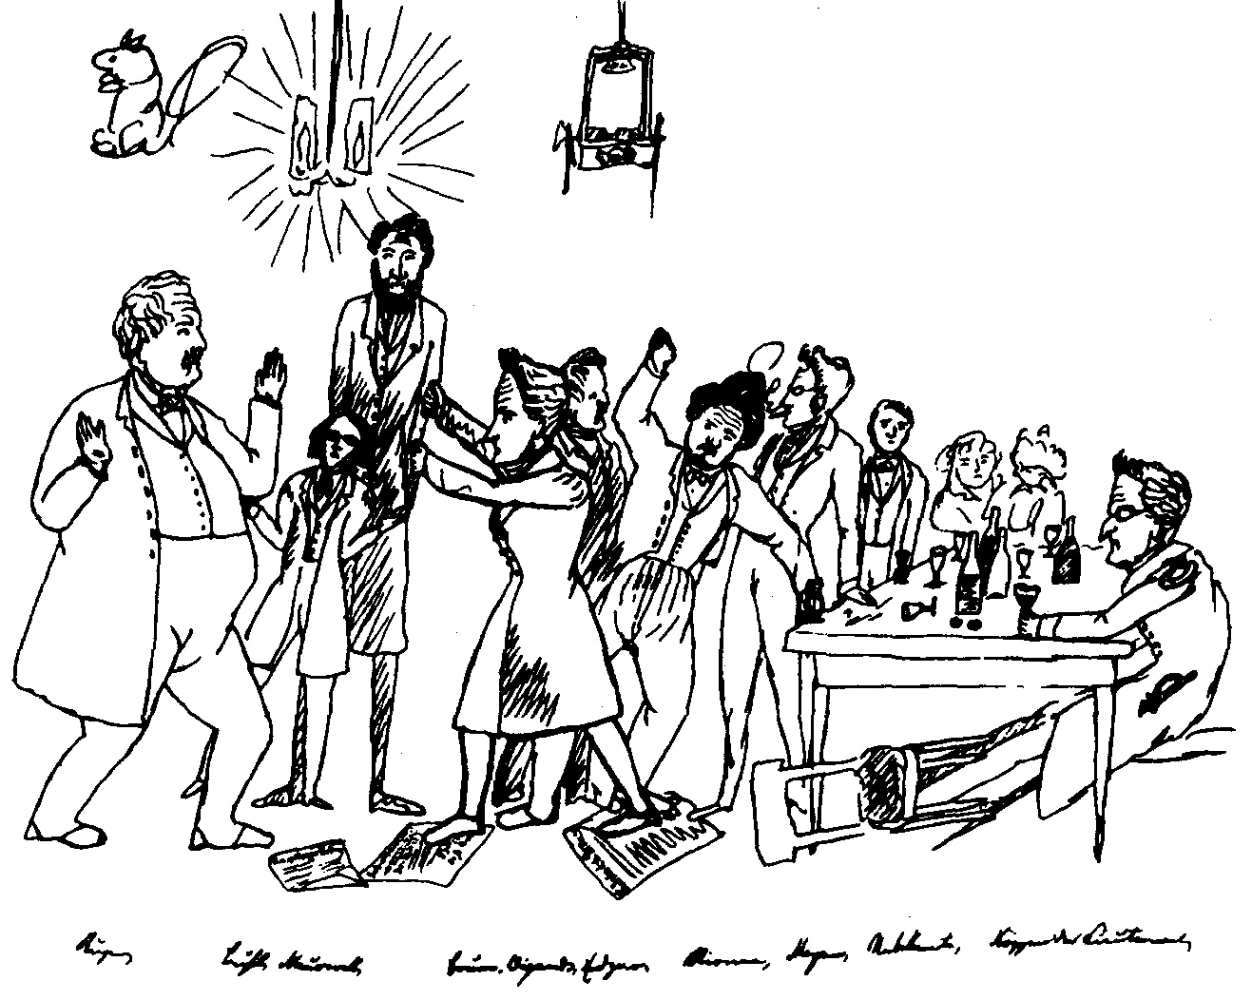

Slide 6
Stirner’s political philosophy
Referenced as a major influence on the development of nihilism, post-modernism, existentialism, and individual anarchism
Opposed to communism, capitalism, humanism, liberalism, property rights and nationalism → saw them as authoritarian forms of domination over the freedom of the individual
Anarchist FAQ (AK Press): "many in the anarchist movement in Glasgow, Scotland, took Stirner's 'Union of egoists' literally as the basis for their anarcho-syndicalist organising in the 1940s and beyond."
Max Nettlau (d. 1944): "[o]n reading Stirner, I maintain that he cannot be interpreted except in a socialist sense."
Stirner: anticapitalist and pro-labor, critiquing "the division of labour resulting from private property for its deadening effects on the ego and individuality of the worker" and writing that free competition "is not 'free,' because I lack the things for competition. [...] Under the regime of the commonality the labourers always fall into the hands of the possessors of the capitalists [...]. The labourer cannot realise on his labour to the extent of the value that it has for the customer. [...] The state rests on the slavery of labour. If labour becomes free, the state is lost."
  "Labor has an egoistic character; the laborer is the egoist.”

Slide 7
Against socialism and the collective
Did not go out of his way to personally speak out again and oppose the struggles carried out by socialists, or influenced by Feuerbach’s humanism, or struggles relating to the advocacy of human rights
  Instead, he attacked their ideal and legal abstractness
He placed the individual and not the collective at the center of his theories
In a letter to Moses Hess, Stirner wrote: "I am not at all against socialism, but against consecrated socialism; my selfishness is not opposed to love [...] nor is it an enemy of sacrifice, nor of self-denial [...] and least of all of socialism [...] —in short, it is not an enemy of true interests; it rebels not against love, but against sacred love, not against thought, but against sacred thought, not against socialists, but against sacred socialism.”

Slide 8
Egoism
In his work, Stirner argues that the fullness of human experience is such that individuals are impossible to completely understand → some of said that his egoism is both psychological and rational
  Unlike the self-interested philosophies of Ayn Rand, Stirner did not focus on individual self-interest or how one should act.
  Urged each individual to fulfill their own egoism by deciding for themselves how they should act
Though sometimes people today use the term “Stirnerism,” he would not agree with this term because he didn’t believe in following an authority figure
Goal is to freely live individual desires → we are each propelled by our own desire and egoism → and we must accept this
  The unwilling egoist: fails to accept this → falsely believes they are fulfilling another cause but are really just fulfilling their own desires for security and happiness.
  The willing egoist: they can act freely, not bound by authority, duty, or obedience to artificial truths like morality, law, rights, and religion
Did not believe in the pursuit of greed → greed is only one aspect of the ego and would lead to being controlled and possessed by a cause other than the fulfillment of the full ego.
Did not believe in natural property rights, encouraged resistance to all forms of authority including property

Slide 9
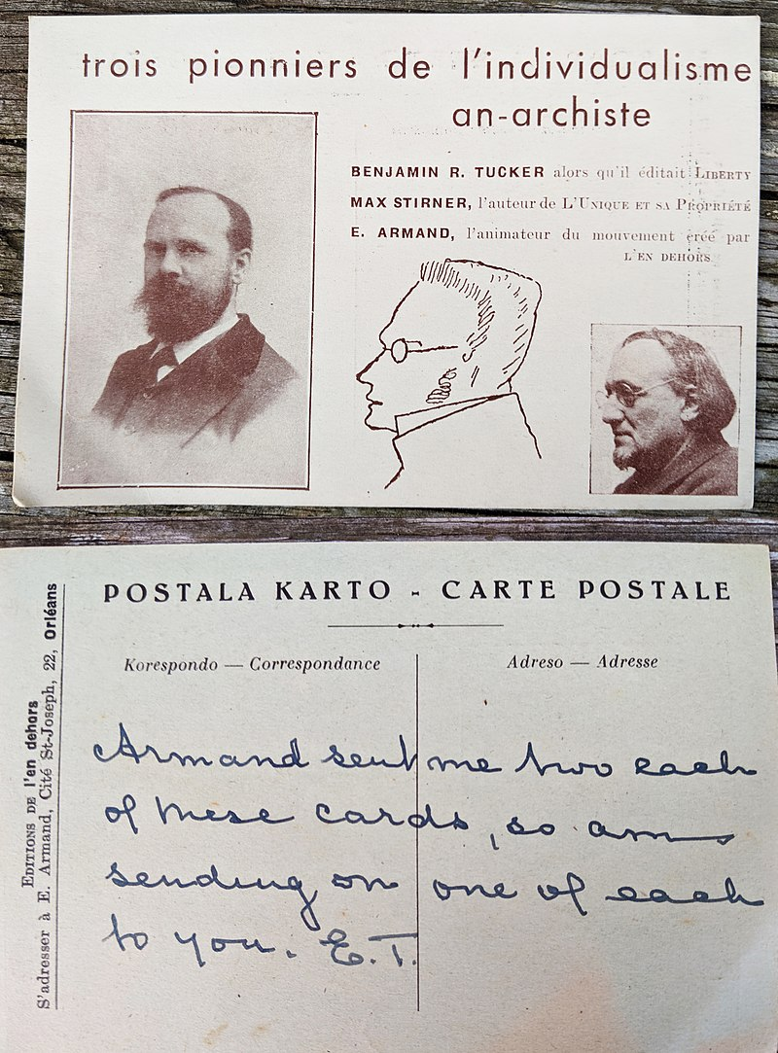
Anarchism (??)
Stirner: most commonly accepted social institutions are mere illusions of the mind
  Includes: the notion of private property, the state, natural rights, the very idea of society
Proposed egoism as a form of amoralism → egoists could unite in a Union of egoists if it was in their self-interest
Property simply comes about through might and power: "Whoever knows how to take and to defend the thing, to him belongs [property]. [...] What I have in my power, that is my own. So long as I assert myself as holder, I am the proprietor of the thing."
  Stirner: "I do not step shyly back from your property, but look upon it always as my property, in which I respect nothing. Pray do the like with what you call my property!“
The world and those in it are free for personal use → no rationality in taking others’ interests into account unless it furthers the egoists own self-interest (the only legitimate reason for acting)
Though he is an important figure in anarchist history, he did not align himself with anarchism and most anarchists in the twentieth and twenty first centuries denounce this theories.
  Most anarchists and anarchist theorists deeply concerned with communal life and common good/happiness

Slide 10
Communism
The Anarchist FAQ Collective: "[w]hile some may object to our attempt to place egoism and communism together, it is worth pointing out that Stirner rejected 'communism'. Stirner did not subscribe to libertarian communism, because it did not exist when he was writing and so he was directing his critique against the various forms of state communism which did. Moreover, this does not mean that anarcho-communists and others may not find his work of use to them. And Stirner would have approved, for nothing could be more foreign to his ideas than to limit what an individual considers to be in their best interest.”
  Though social and communal anarchists might sneer at Stirner’s self-interested individualism, there are important critiques of authority and the state within his work.
Daniel Guérin: "Stirner accepted many of the premises of communism but with the following qualification: the profession of communist faith is a first step toward total emancipation of the victims of our society, but they will become completely 'disalienated,' and truly able to develop their individuality, only by advancing beyond communism."

Slide 11
Reponse to Hegelianism
Lawrence Stepelevich: Hegel was a major influence on The Ego and Its Own.
  Ego generally has "un-Hegelian structure and tone" and is critical of Hegel's conclusions about the self and the world
  Stepelevich: Should understand Stirner’s work as answering Hegel's question of the role of consciousness after it has contemplated "untrue knowledge" and become "absolute knowledge.“
  Stirner explores the outcome of the rediscovering one's self-consciousness after realizing self-determination.
Though a student of Hegel, he was not necessarily a Hegelian (like Feuerbach and other contemporaries who were Hegelians)
Against his peers (the Young Hegelians), Stirner ignored or scorned any attempt at political engagement/critique of Hegel and the Enlightenment philosophers.

Slide 12
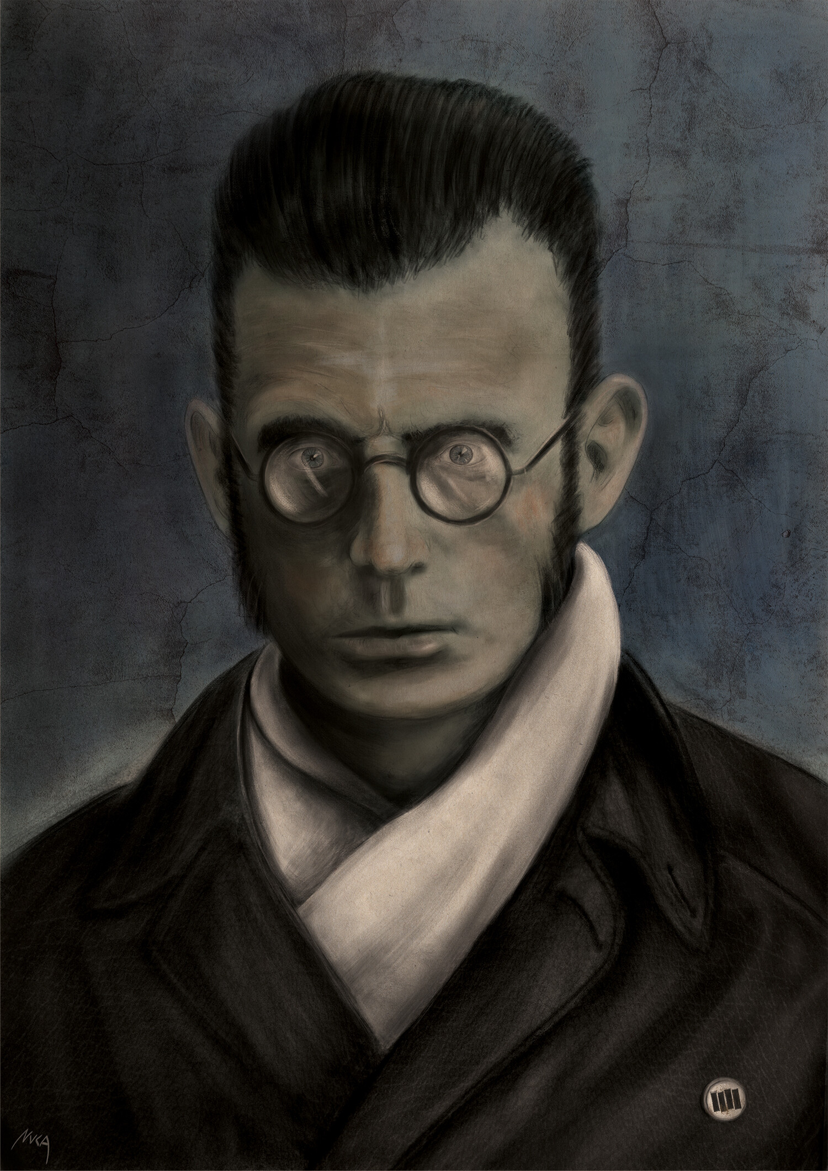
Stirner abandons philosophy
Douglas Moggach: Stirner does not evolve beyond Hegel, but leaves philosophy in its entirely:
“Stirner refused to conceptualize the human self, and rendered it devoid of any reference to rationality or universal standards. The self was moreover considered a field of action, a "never-being I." The "I" had no essence to realize and life itself was a process of self-dissolution. Far from accepting, like the humanist Hegelians, a construal of subjectivity endowed with a universal and ethical mission, Stirner's notion of "the Unique" (Der Einzige) distances itself from any conceptualization whatsoever: "There is no development of the concept of the Unique. No philosophical system can be built out of it, as it can out of Being, or Thinking, or the I. Rather, with it, all development of the concept ceases. The person who views it as a principle thinks that he can treat it philosophically or theoretically and necessarily wastes his breath arguing against it.”
"Hegelianism in Restoration Prussia, 1841–1848: Freedom, Humanism and 'Anti-Humanism' in Young Hegelian Thought.", In: Hegel's Thought in Europe: Currents, Crosscurrents and Undercurrents, ed. Lisa Herzog (pp. 71–92). Basingstoke and New York: Palgrave Macmillan, 2013, p. 75.

Slide 13
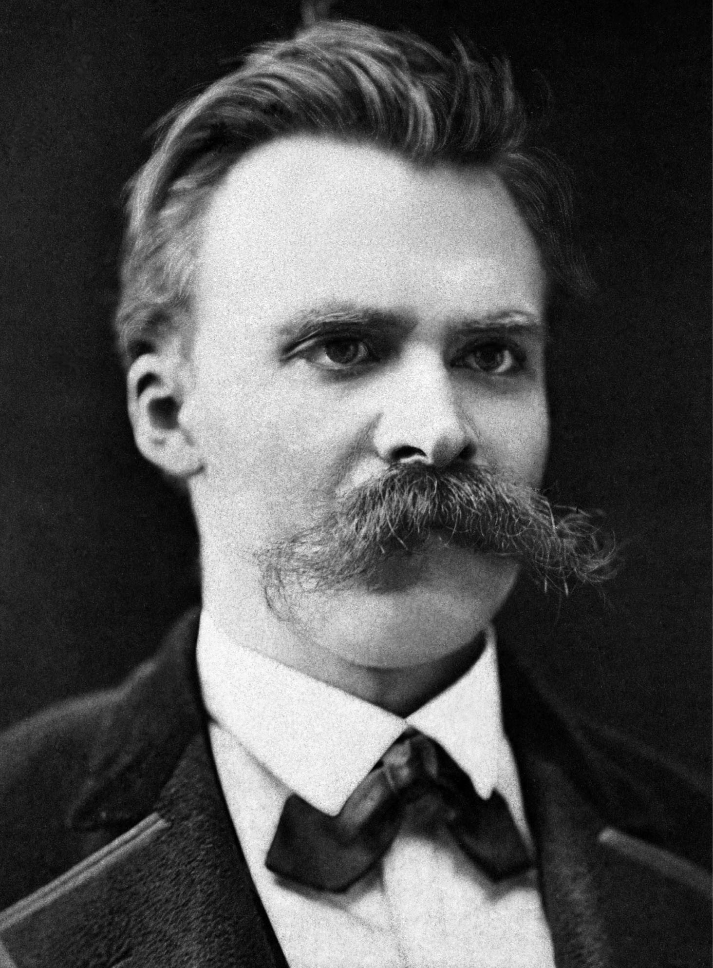
Possible influence on Nietzsche
Theories of Nietzsche (d. 1900) and Stirner (d. 1856) often compared → raises question of influence
During Nietzsche’s early emergence as a prominent philosopher in Germany, the only philosopher discussed more in connection to his work than Stirner was Shopenhauer
Nietzsche has knowledge of the existence of Ego and Its Own, but unclear if he ever read it → no mention of Stirner anywhere in his works
  Did spend time with friends of Stirner, but no evidence that he directly engaged with Stirner’s work
The possible influence of Stirner on Nietzsche began to be discussed as soon as his work began to reach a broader audience
As early as 1891, people began to suggest that he had plagiarized Stirner → the belief that he was influenced by Stirner so widespread that it was commonplace in Germany: "Stirner's influence in modern Germany has assumed astonishing proportions, and moves in general parallel with that of Nietzsche. The two thinkers are regarded as exponents of essentially the same philosophy.“(O. Ewald, "German Philosophy in 1907“)

